Slide 1

Introduction to Computer Science
Reichman University
Lecture 3-1
Approximation Algorithms
Notes:
1

Slide 2
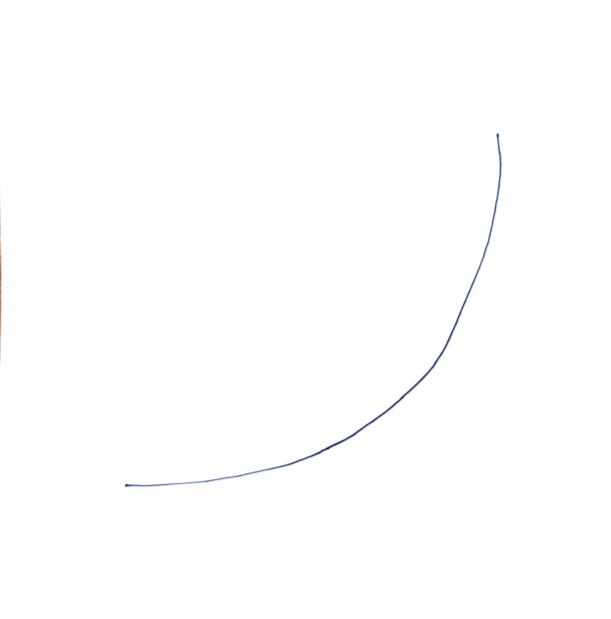
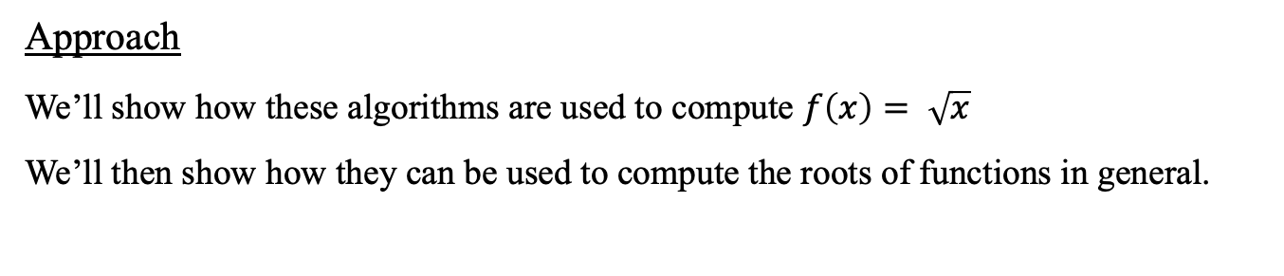
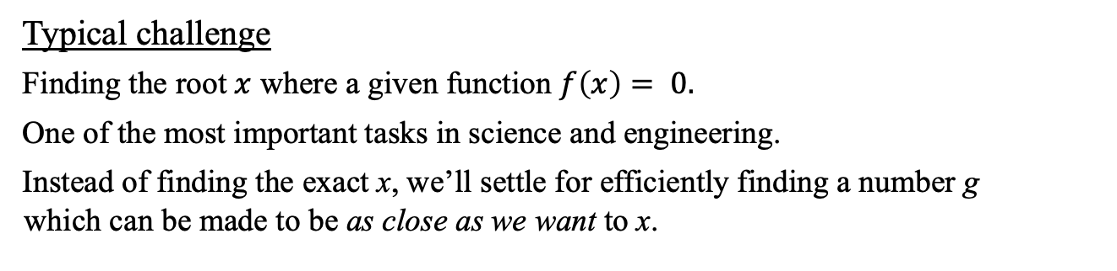
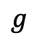
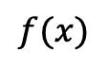
Approximation algorithms
Typical challenge
Finding the root $x$ where a given function $f\left(x\right)= 0.$
One of the most important tasks in science and engineering.
Instead of finding the exact x, we’ll settle for efficiently finding a number g which can be made to be as close as we want to x.
Numeric algorithms
Sequential search
Bisection
Newton - Raphson
$$f(x)$$
$$g$$
Approach
We’ll show how these algorithms are used to compute $f\left(x\right)= \sqrt{x}$
We’ll then show how they can be used to compute the roots of functions in general.

Slide 3
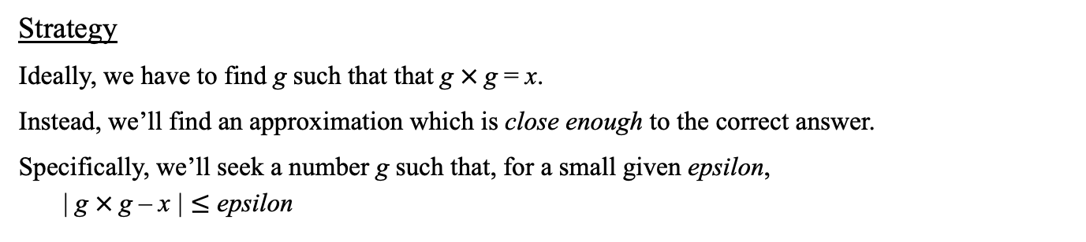
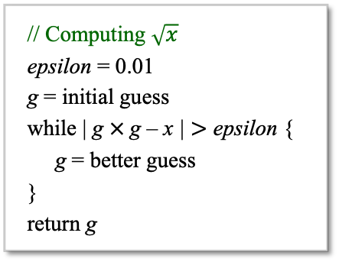
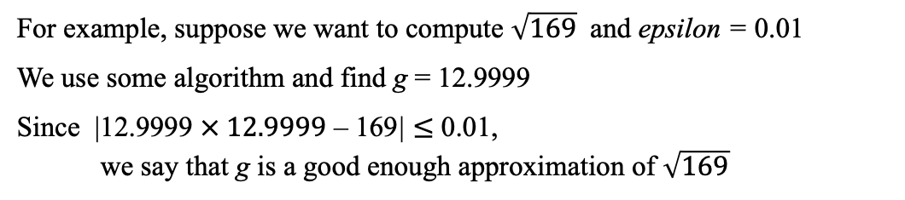
Approximation algorithms
Task: Calculate $\sqrt{x}$ for x > 1
Strategy
Ideally, we have to find g such that that g $×$g = x.
Instead, we’ll find an approximation which is close enough to the correct answer.
Specifically, we’ll seek a number g such that, for a small given epsilon, | g $×$g – x | $≤$ epsilon
For example, suppose we want to compute $\sqrt{169}$ and epsilon = 0.01
We use some algorithm and find g = 12.9999
Since |12.9999 $× 12.9999$ – 169| $≤$ 0.01, we say that g is a good enough approximation of $\sqrt{169}$
// Computing $\sqrt{x}$
epsilon = 0.01
g = initial guess
while | g $×$g – x | $>$ epsilon {
g = better guess
}
return g

Slide 4
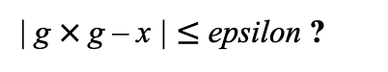
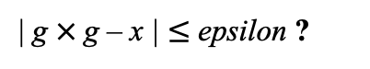
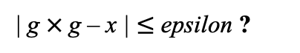
Sequential search (“brute force”)
Task: Calculate $\sqrt{x}$ for x > 1
Itr. 0: The square root of x must be between 1 and x, so let’s start with g = 1:
g
| g $×$g – x | $≤$ epsilon ?
1
x
Itr. 1: g = g + increment (increment = a small number, like 0.001)
0
g
| g $×$g – x | $≤$ epsilon ?
x
Itr. 2: g = g + increment
0
g
| g $×$g – x | $≤$ epsilon ?
x
Continue until | g $×$g – x | $≤$ epsilon
Performance
The smaller is epsilon, the more accurate is the answer
The smaller is increment, the slower is the computation
Running time: Less than x / increment iterations.

Slide 5
Sequential search (“brute force”)
// Computes an approximate square root by sequential search
public class Sqrt1 {
public static void main(String args[]) {
double x = 16; // we’ll find the (approx.) square root of x
double epsilon = 0.01, increment = 0.0001;
abs
% java Sqrt1 (x = 16)
Square root (approx.) = 3.998800000004108
Number of iterations = 29988

Slide 6
Sequential search (“brute force”)
// Computes an approximate square root by sequential search
public class Sqrt1 {
public static void main(String args[]) {
double x = 16; // we’ll find the (approx.) square root of x
double epsilon = 0.01, increment = 0.0001;
double g = 1.0;
int stepCounter = 0;
while (Math.abs(g * g - x) >= epsilon) {
g += increment;
stepCounter++;
}
System.out.println("Square root (approx.) = " + g);
System.out.println("Number of iterations = " + stepCounter);
}
}
% java Sqrt1 (x = 16)
Square root (approx.) = 3.998800000004108
Number of iterations = 29988

Slide 7
Sequential search (“brute force”)
// Computes an approximate square root by sequential search
public class Sqrt1 {
public static void main(String args[]) {
double x = 16; // we’ll find the (approx.) square root of x
double epsilon = 0.01, increment = 0.0001;
double g = 1.0;
int stepCounter = 0;
while (Math.abs(g * g - x) >= epsilon) {
g += increment;
stepCounter++;
}
System.out.println("Square root (approx.) = " + g);
System.out.println("Number of iterations = " + stepCounter);
}
}
Slow…
% java Sqrt1 (x = 16)
Square root (approx.) = 3.998800000004108
Number of iterations = 29988
% java Sqrt1 (x = 100)
Square root (approx.) = 9.999499999990128
Number of iterations = 89995
% java Sqrt1 (x = 105)
Square root (approx.) = 10.246499999989553
Number of iterations = 92465
Bug
If increment is too large, we can miss the answer, and get into an infinite loop

Slide 8
Sequential search (“brute force”)
// Computes an approximate square root by sequential search
public class Sqrt1 {
public static void main(String args[]) {
double x = 16; // we’ll find the (approx.) square root of x
double epsilon = 0.01, increment = 0.0001;
double g = 1.0;
int stepCounter = 0;
while ((Math.abs(g * g - x) >= epsilon) && (g <= x)) {
g += increment;
stepCounter++;
}
if (g > x) {
System.out.println("Failed to find a solution");
} else {
System.out.println("Square root (approx.) = " + g);
}
}
}
abs
Slow…

Slide 9
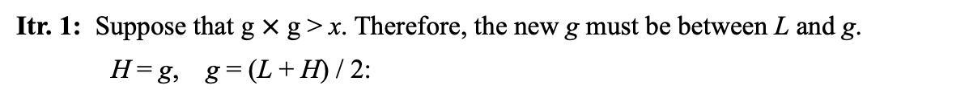
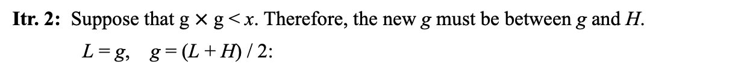
Bi-section search
Task: Calculate $\sqrt{x}$ for x > 1
Itr. 0: Initialize L = 1, H = x, g = (L + H) / 2:
L
g
H
1
x
Itr. 1: Suppose that g $×$ g > x. Therefore, the new g must be between L and g.
H = g, g = (L + H) / 2:
L
g
H
x
Itr. 2: Suppose that g $×$ g < x. Therefore, the new g must be between g and H.
L = g, g = (L + H) / 2:
1
L
g
H
x
Continue: Until | g $×$g – x | $≤$ epsilon
We know that

Slide 10
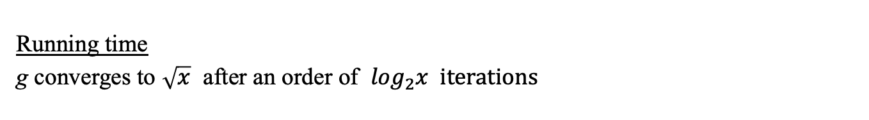
Bi-section search
Performance
In itr. 0, search space: x
In itr. 1, search space: x / 2
In itr. 2, search space: x / 4
In itr. 3, search space: x / 8
In itr. k, search space: x / 2^{k}
Running time
g converges to $\sqrt{x}$ after an order of $\log_{2}x iterations$
We know that

Slide 11
Bi-section search
// Computes an approximate square root by bi-section search
public class Sqrt2 {
public static void main(String args[]) {
double x = 16;
abs
% java Sqrt2 (x = 16)
Square root (approx.) = 3.999267578125
Number of iterations = 11
% java Sqrt2 (x = 105)
Square root (approx.) = 10.2469482421875
Number of iterations = 15

Slide 12
Bi-section search
// Computes an approximate square root by bi-section search
public class Sqrt2 {
public static void main(String args[]) {
double x = 16;
double epsilon = 0.01, L = 1.0, H = x;
double g = (L + H) / 2.0;
int stepCounter = 0;
while (Math.abs(g * g - x) >= epsilon) {
if (g * g < x)
L = g;
else
H = g;
g = (L + H) / 2;
stepCounter++;
}
System.out.println("Square root (approx.) = " + g);
System.out.println("Number of iterations = " + stepCounter);
}
}
abs
% java Sqrt2 (x = 16)
Square root (approx.) = 3.999267578125
Number of iterations = 11
% java Sqrt2 (x = 105)
Square root (approx.) = 10.2469482421875
Number of iterations = 15
Fast!

Slide 13
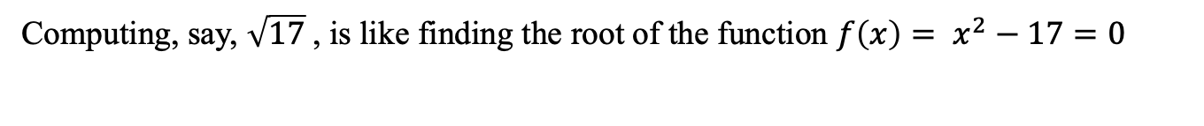
Bi-section search: Calculus intuition
Computing, say, $\sqrt{17}$, is like finding the root of the function $f\left(x\right)= x^{2}−17=0$

Slide 14

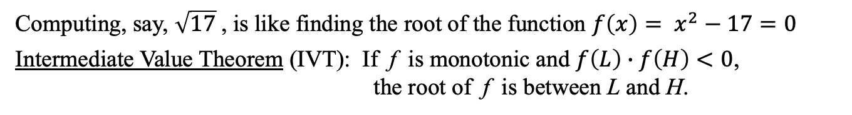
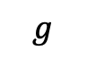
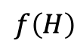
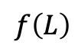
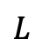
Bi-section search: Calculus intuition
Computing, say, $\sqrt{17}$, is like finding the root of the function $f\left(x\right)= x^{2}−17=0$
Intermediate Value Theorem (IVT): If f is monotonic and $f\left(L\right)∙f\left(H\right)<0$, the root of f is between L and H.
$$f\left(H\right)$$
$$L_{}$$
$$g$$
$$H_{}$$
$$f\left(L\right)$$

Slide 15
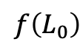
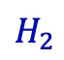

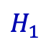
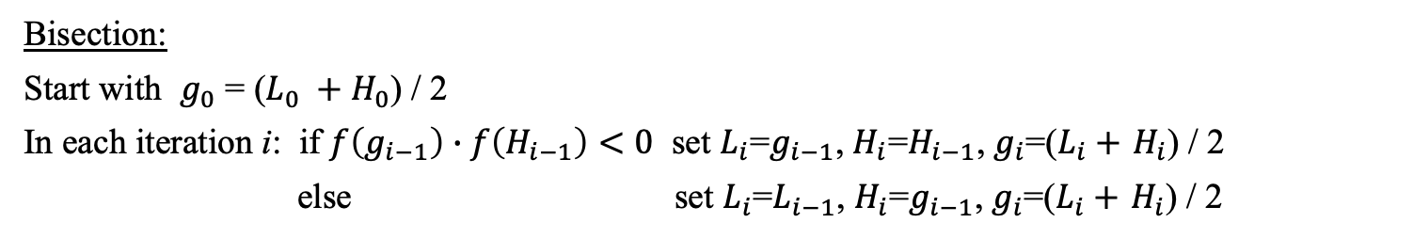
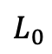
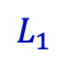
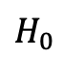
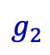
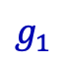
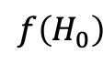
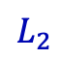
Bi-section search: Calculus intuition
Computing, say, $\sqrt{17}$, is like finding the root of the function $f\left(x\right)= x^{2}−17=0$
Intermediate Value Theorem (IVT): If f is monotonic and $f\left(L\right)∙f\left(H\right)<0$, the root of f is between L and H.
$$f\left(H_{0}\right)$$
$$L_{0}$$
$$g_{0}$$
$$H_{0}$$
iteration 0
$$L_{1}$$
$$g_{1}$$
$$H_{1}$$
iteration 1
$$f\left(L_{0}\right)$$
$$L_{2}$$
$$g_{2}$$
$$H_{2}$$
iteration 2
etc...
Bisection:
Start with $g_{0}$ = ($L_{0} +H_{0}$) / 2
In each iteration i: if $f\left(g_{i−1}\right)∙f\left(H_{i−1}\right)<0$ set $L_{i}$=$g_{i−1}$, $H_{i}$=$H_{i−1}$, $g_{i}$=($L_{i}+$ $H_{i}$) / 2
else set $L_{i}$=$L_{i−1}$, $H_{i}$=$g_{i−1}$, $g_{i}$=($L_{i}+$ $H_{i}$) / 2

Slide 16
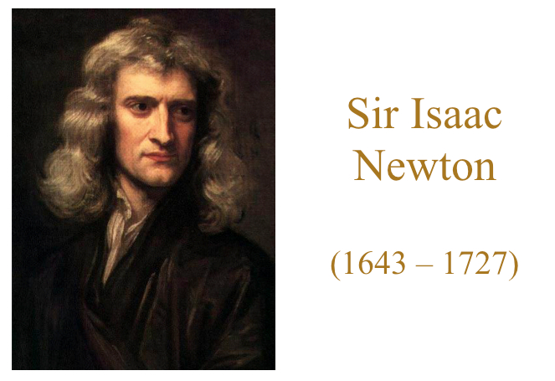
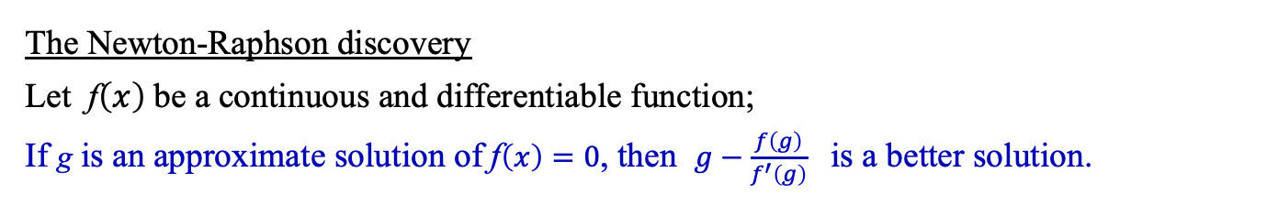
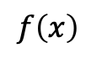
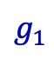

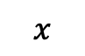
Bi-section search: Calculus intuition
The Newton-Raphson discovery
Let f$\left(x\right)$be a continuous and differentiable function;
If g is an approximate solution of f$\left(x\right)=0$, then $g−\frac{f\left(g\right)}{f^{′}\left(g\right)}$ is a better solution.
$$f\left(x\right)$$
$$x$$
Isaac Newton (1643 - 1727)
$$g_{1}$$
$$g_{0}$$

Slide 17

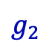
Bi-section search: Calculus intuition
The Newton-Raphson discovery
Let f$\left(x\right)$be a continuous and differentiable function;
If g is an approximate solution of f$\left(x\right)=0$, then $g−\frac{f\left(g\right)}{f^{′}\left(g\right)}$ is a better solution.
$$f\left(x\right)$$
$$x$$
Isaac Newton (1643 - 1727)
$$g_{2}$$
$$g_{1}$$
$$g_{0}$$

Slide 18
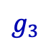
Bi-section search: Calculus intuition
The Newton-Raphson discovery
Let f$\left(x\right)$be a continuous and differentiable function;
If g is an approximate solution of f$\left(x\right)=0$, then $g−\frac{f\left(g\right)}{f^{′}\left(g\right)}$ is a better solution.
$$f\left(x\right)$$
$$x$$
Isaac Newton (1643 - 1727)
$$g_{3}$$
$$g_{2}$$
$$g_{1}$$
$$g_{0}$$
These geometric insights led to the discovery of such concepts as derivative (נגזרת), tangent (שיפוע), convergence (התכנסות), limit (גבול), ...

Slide 19
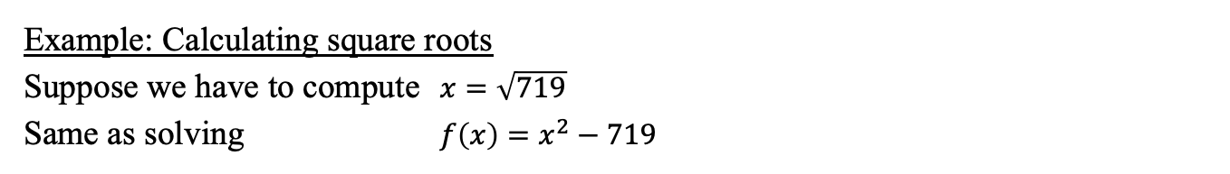
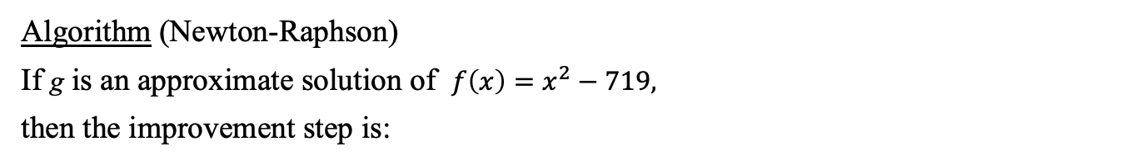
Newton-Raphson method
The Newton-Raphson discovery
Let f$\left(x\right)$be a continuous and differentiable function;
If g is an approximate solution of f$\left(x\right)=0$, then $g−\frac{f\left(g\right)}{f^{′}\left(g\right)}$ is a better solution.
Example: Calculating square roots
Suppose we have to compute$x=\sqrt{719}$
Same as solving $f\left(x\right)=x^{2}−719$
Algorithm (Newton-Raphson)
If g is an approximate solution of $f\left(x\right)=x^{2}−719,$
then the improvement step is:
$$g ←g−\left(g^{2}−719\right) / (2∙g)$$

Slide 20
Newton-Raphson method
// Uses Newton-Raphson search to approximate sqrt(x).
public class Sqrt3 {
public static void main(String args[]) {
double x = 16;
double epsilon = 0.01;
int stepCounter = 0;
double g = x / 2;
while (Math.abs(g * g - x) > epsilon) {
stepCounter++;
g = g - (g * g - x) / (2 * g);
System.out.println("Step " + stepCounter + ": g = " + g);
}
System.out.println("Square root (approx.) = " + g);
}
}
Wow
% java Sqrt3 (x = 16)
Step 1: g = 5.0
Step 2: g = 4.1
Step 3: g = 4.001219512195122
Square root (approx.) = 4.001219512195122
% java Sqrt3 (x = 105)
Step 1: g = 27.25
Step 2: g = 15.551605504587156
Step 3: g = 11.151659989960418
Step 4: g = 10.283649283522411
Step 5: g = 10.247016247636102
Square root (approx.) = 10.247016247636102

Slide 21
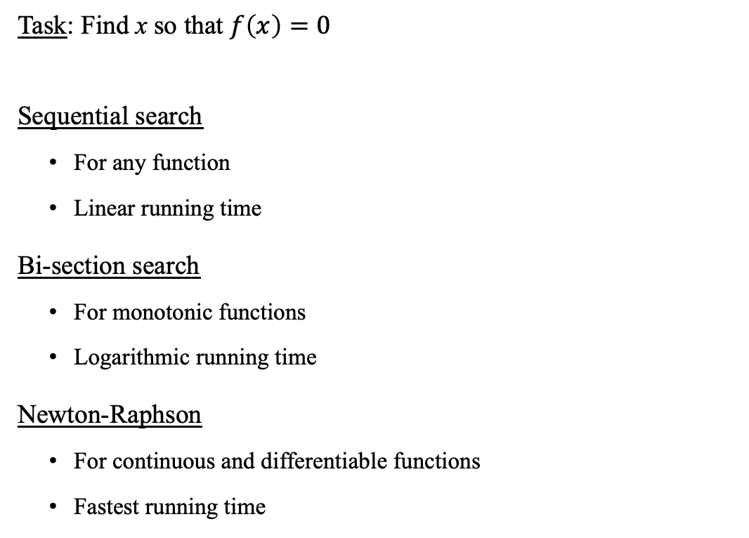
Approximation algorithms
Task: Find x so that $f\left(x\right)=0$
Sequential search
For any function
Linear running time
Bi-section search
For monotonic functions
Logarithmic running time
Newton-Raphson
For continuous and differentiable functions
Fastest running time

Slide 22

Introduction to Computer Science
Shimon Schocken
IDC Herzliya
Lecture 3-1
Functions
x
y
f (x, y, z)
z
f
(Functions in programming are related to, but quite different from, mathematical functions)
Notes:
22

Slide 23
The big picture
any program you may want to write
objects
handling graphics, sound, and images
arrays
functions
conditionals and loops
Math
text I/O
primitive data types
variables

Slide 24
The big picture
any program you may want to write
objects
handling graphics, sound, and images
arrays
functions
this lecture
conditionals and loops
Math
text I/O
primitive data types
variables

Slide 25
Overview
public class Sqrt3 {
public static void main(String args[]) {
double x = Double.parseDouble(args[0]);
double epsilon = 0.01;
double g = x;
while (Math.abs(g * g - x) > epsilon) {
g = g - (g * g - x) / (2 * g);
}
System.out.println("Square root (approx.) = " + g);
}
}

Slide 26
Overview
public class Sqrt3 {
public static void main(String args[]) {
double x = Double.parseDouble(args[0]);
double epsilon = 0.01;
double g = x;
while (Math.abs(g * g - x) > epsilon) {
g = g - (g * g - x) / (2 * g);
}
System.out.println("Square root (approx.) = " + g);
}
}
public class MyMath {
public static void main(String args[]) {
double x = Double.parseDouble(args[0]);
System.out.println("Square root (approx.) = " + sqrt(x));
}
// Computes sqrt(x)
public static double sqrt(double x) {
double epsilon = 0.01;
double g = x;
while (Math.abs(g * g - x) > epsilon) {
g = g - (g * g - x) / (2 * g);
}
return g;
}
}
function call
Refactoring the square root computation:
Sqrt became a stand-alone function, in a MyMath library
The main function became a tester
function declaration
return value

Slide 27
Overview
public class MyMath {
/** Computes square root with precision epsilon */
public static double sqrt(double x, double epsilon) {
if (x < 0) return Double.NaN;
double g = x;
while (Math.abs(g * g - x) > epsilon) {
g = g - (g * g - x) / (2 * g);
}
return g;
}
// More MyMath functions
}
A finer sqrt version

Slide 28
Overview
public class MyMath {
public static void main(String args[]) {
// Tests the square root function with various precisions:
System.out.println(Math.sqrt(2)); // benchmark value
System.out.println(sqrt(2, 0.5));
System.out.println(sqrt(2, 0.1));
System.out.println(sqrt(2, 0.001));
System.out.println(sqrt(2, 1e-7)); // 0.00000001
}
/** Computes square root with precision epsilon */
public static double sqrt(double x, double epsilon) {
if (x < 0) return Double.NaN;
double g = x;
while (Math.abs(g * g - x) > epsilon) {
g = g - (g * g - x) / (2 * g);
}
return g;
}
// More MyMath functions
}
% java MyMath
1.4142135623730951
1.5
1.4166666666666665
1.4142156862745097
1.4142135623746899
A finer sqrt version

Slide 29
Function anatomy
public static double sqrt(double x, double epsilon) {
if (x < 0) return Double.NaN;
double g = x;
while (Math.abs(g * g - x) > epsilon) {
g = g - (g * g - x) / (2 * g);
}
return g;
}

Slide 30
Function anatomy
type of return value
function name
parameter type
parameter name
function declaration
public static double sqrt(double x, double epsilon) {
if (x < 0) return Double.NaN;
double g = x;
while (Math.abs(g * g - x) > epsilon) {
g = g - (g * g - x) / (2 * g);
}
return g;
}
local
variable (g)
function
body
return value
A function
Takes zero, one, or more inputs (“parameters”)
Either:
Returns a value, or
Does not return a value (void function, later)

Slide 31
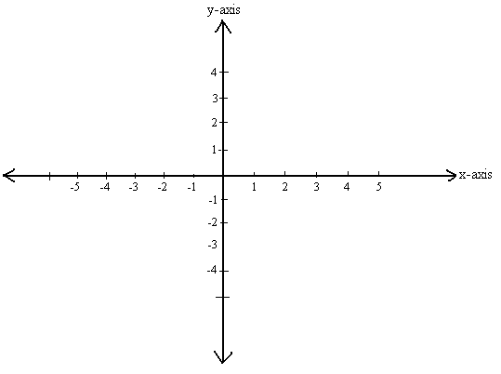
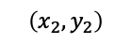
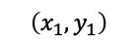
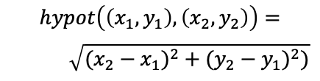
Function examples
$$\left(x_{2},y_{2}\right)$$
public class MyMath {
/** Computes the Euclidean distance between (x1,x2) and (y1,y1) */
public static double hypot(double x1, double y1,
double x2, double y2) {
double dx = x2 - x1;
double dy = y2 - y1;
return sqrt(dx*dx + dy*dy);
}
}
hypot
$$\left(x_{1},y_{1}\right)$$
$$hypot\left(\left(x_{1},y_{1}\right),\left(x_{2},y_{2}\right)\right)=$$
$$\sqrt{({x_{2}−x_{1})}^{2}+({y_{2}−y_{1})}^{2})}$$
Euclidean distance
Widely used
Nice to have: a function that computes it

Slide 32
Function examples
$$\left(x_{2},y_{2}\right)$$
public class MyMath {
public static void main(String args[]) {
/** Computes and prints a Euclidean distance */
double d = hypot(2,1,5,4);
System.out.println(d);
}
/** Computes the Euclidean distance between (x1,x2) and (y1,y1) */
public static double hypot(double x1, double y1,
double x2, double y2) {
double dx = x2 - x1;
double dy = y2 - y1;
return sqrt(dx*dx + dy*dy);
}
/** Computes sqrt(x) */
public static double sqrt(double x) {
double epsilon = 0.01;
double g = x;
while (Math.abs(g * g - x) > epsilon) {
g = g - (g * g - x) / (2 * g);
}
return g;
}
... // More functions come here
}
hypot
$$\left(x_{1},y_{1}\right)$$
$$hypot\left(\left(x_{1},y_{1}\right),\left(x_{2},y_{2}\right)\right)=$$
$$\sqrt{({x_{2}−x_{1})}^{2}+({y_{2}−y_{1})}^{2})}$$
Euclidean distance
Widely used
Nice to have: a function that computes it
% java MyMath
4.242642472890547

Slide 33
Function examples
public class MyMath {
public static void main(String args[]) {
/** Computes and prints a Euclidean distance */
double d = hypot(2,1,5,4);
System.out.println(d);
}
/** Computes the Euclidean distance between (x1,x2) and (y1,y1) */
public static double hypot(double x1, double y1,
double x2, double y2) {
double dx = x2 - x1;
double dy = y2 - y1;
return sqrt(dx*dx + dy*dy);
}
/** Computes sqrt(x) */
public static double sqrt(double x) {
double epsilon = 0.01;
double g = x;
while (Math.abs(g * g - x) > epsilon) {
g = g - (g * g - x) / (2 * g);
}
return g;
}
... // More functions come here
}
Observations
Class: A collection of one or more functions
This particular class: A library of common math functions
The main function is often used to test/demo the other functions.
% java MyMath
4.242642472890547

Slide 34

Functions
Function anatomy
Function call and return
Overloading
Software engineering issues

Slide 35
Calling a function
public class MyMath {
public static void main(String args[]) {
...
double d = hypot(2,1,5,4);
...
}
public static double hypot(double x1, double y1,
double x2, double y2) {
double dx = x2 - x1;
double dy = y2 - y1;
return sqrt(dx*dx + dy*dy);
}
public static double sqrt(double x) {
double epsilon = 0.01;
double g = x;
while (Math.abs(g * g - x) > epsilon) {
g = g - (g * g - x) / (2 * g);
}
return g;
}
...
}

Slide 36
Calling a function
public class MyMath {
public static void main(String args[]) {
...
double d = hypot(2,1,5,4);
...
}
public static double hypot(double x1, double y1,
double x2, double y2) {
double dx = x2 - x1;
double dy = y2 - y1;
return sqrt(dx*dx + dy*dy);
}
public static double sqrt(double x) {
double epsilon = 0.01;
double g = x;
while (Math.abs(g * g - x) > epsilon) {
g = g - (g * g - x) / (2 * g);
}
return g;
}
...
}
Terminology
The calling function = caller
The called function = callee
main calls hypot
Calling a function:
The caller passes arguments to the callee
The caller suspends its execution, and waits for the callee to terminate
Control transfers to the callee, which starts executing.
hypot calls sqrt
sqrt calls Math.abs

Slide 37
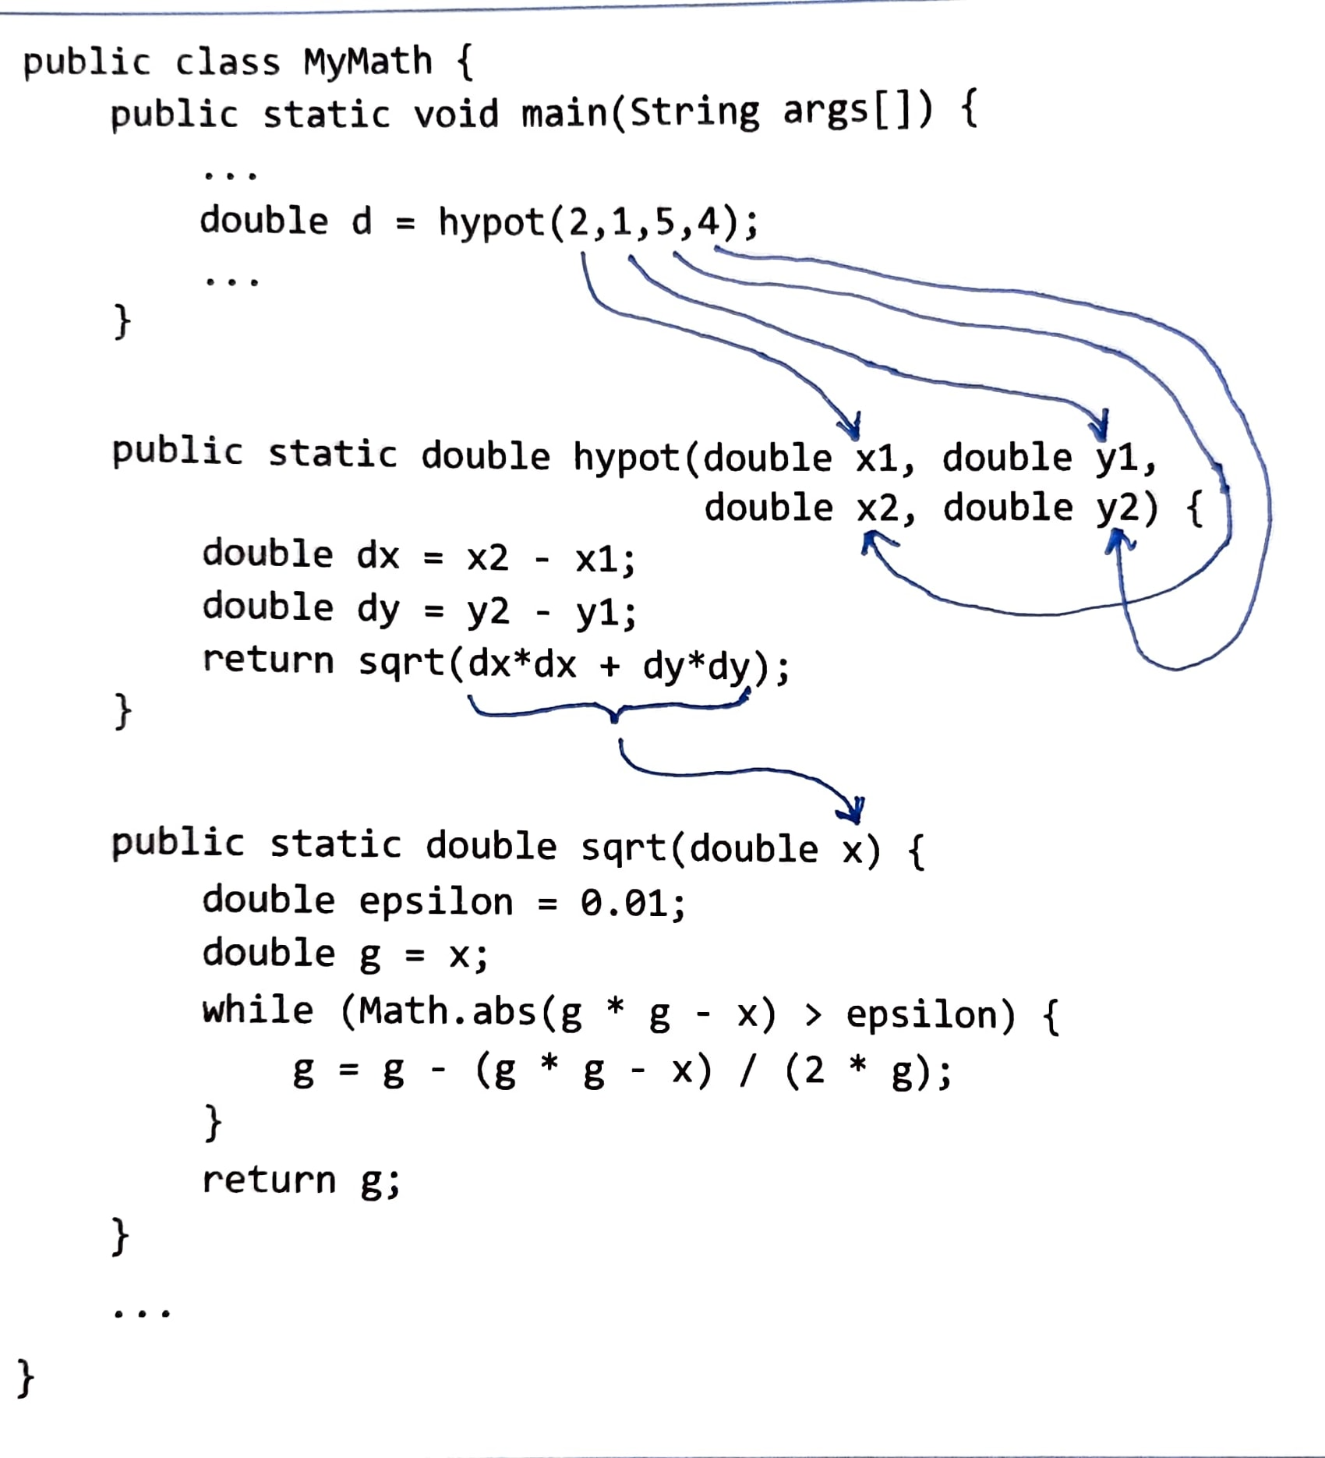
Calling a function
public class MyMath {
public static void main(String args[]) {
...
double d = hypot(2,1,5,4);
...
}
public static double hypot(double x1, double y1,
double x2, double y2) {
double dx = x2 - x1;
double dy = y2 - y1;
return sqrt(dx*dx + dy*dy);
}
public static double sqrt(double x) {
double epsilon = 0.01;
double g = x;
while (Math.abs(g * g - x) > epsilon) {
g = g - (g * g - x) / (2 * g);
}
return g;
}
...
}
x1 is initialized to 2
y1 is initialized to 1
x2 is initialized to 5
y2 is initialized to 4
x is initialized to the value of dx*dx + dy*dy
Terminology
Arguments:
The values that the caller passes
Parameters:
Similar to local variables: initialized by the arguments supplied by the caller

Slide 38
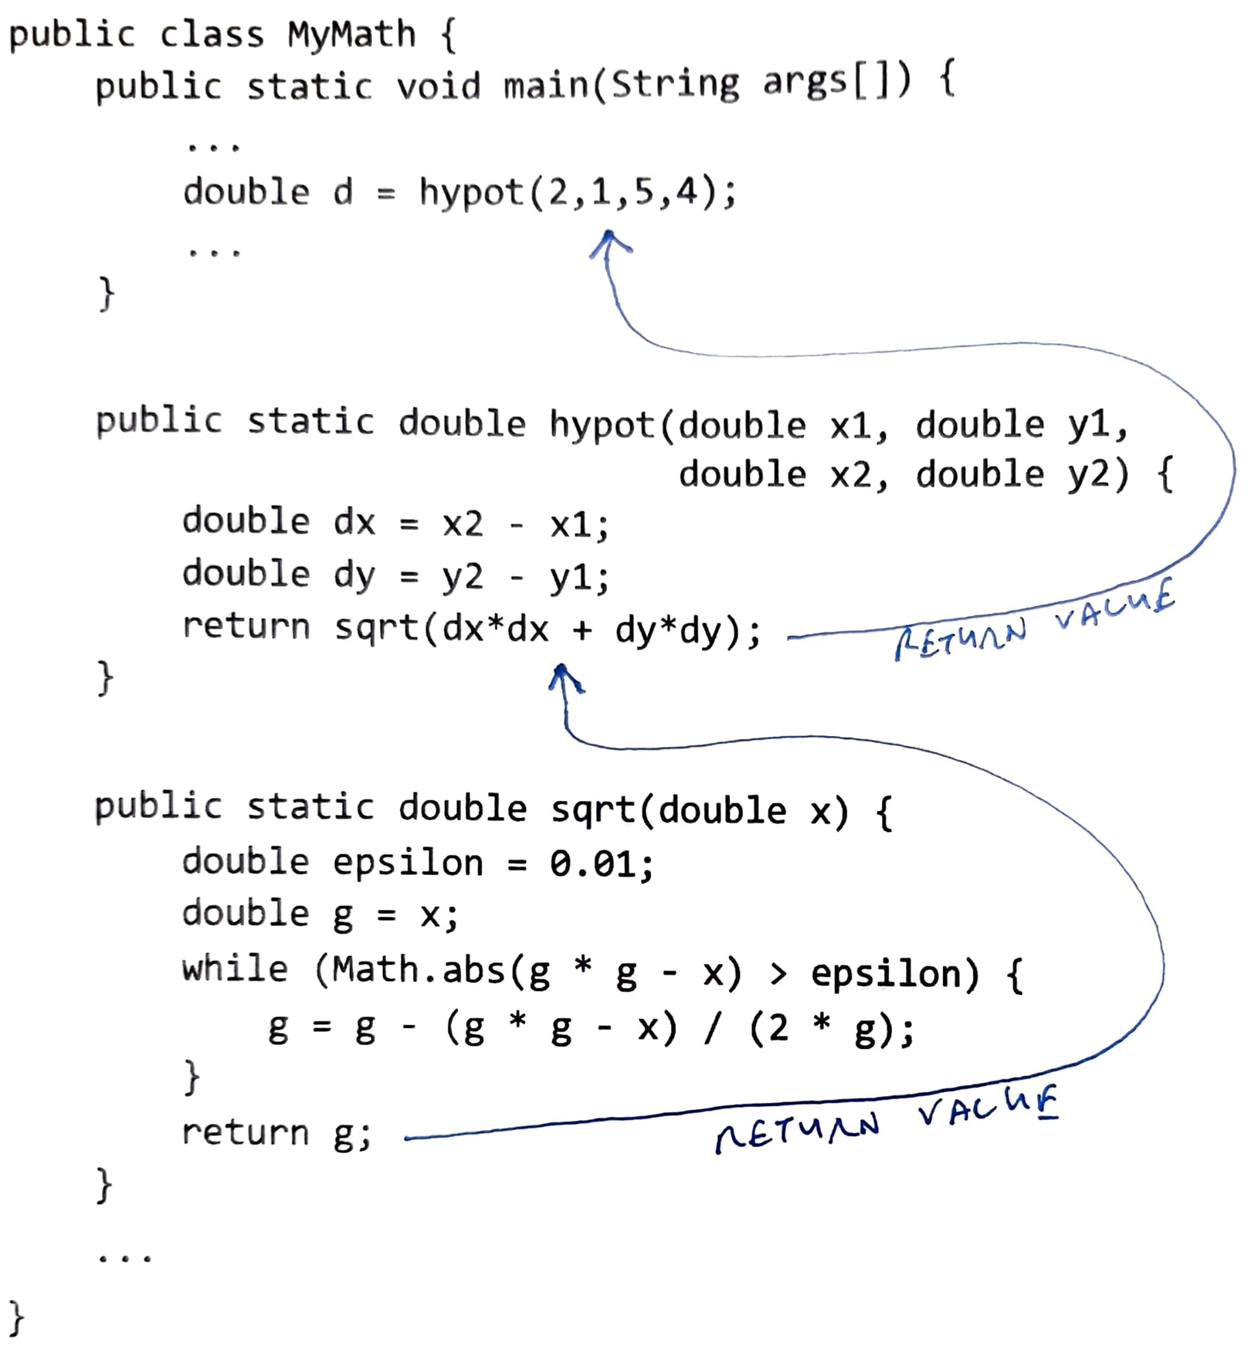
Returning from a function call
public class MyMath {
public static void main(String args[]) {
...
double d = hypot(2,1,5,4);
...
}
public static double hypot(double x1, double y1,
double x2, double y2) {
double dx = x2 - x1;
double dy = y2 - y1;
return sqrt(dx*dx + dy*dy);
}
public static double sqrt(double x) {
double epsilon = 0.01;
double g = x;
while (Math.abs(g * g - x) > epsilon) {
g = g - (g * g - x) / (2 * g);
}
return g;
}
...
}
main calls hypot
When the callee returns:
The return value replaces the function call in the caller’s code
The caller continues its execution.
hypot calls sqrt
sqrt calls Math.abs

Slide 39
Function call and return: simulation
public class MyMath {
public static void main(String args[]) {
...
double d = hypot(2,1,5,4);
system.Out.println(d);
}
public static double hypot(double x1, double y1,
double x2, double y2) {
double dx = x2 - x1;
double dy = y2 - y1;
return sqrt(dx*dx + dy*dy);
}
public static double sqrt(double x) {
double epsilon = 0.01;
double g = x;
while (Math.abs(g * g - x) > epsilon) {
g = g - (g * g - x) / (2 * g);
}
return g;
}
...
}
% java MyMath
4.242642472890547

Slide 40
Function call and return: simulation
public class MyMath {
public static void main(String args[]) {
...
double d = hypot(2,1,5,4);
system.Out.println(d);
}
public static double hypot(double x1, double y1,
double x2, double y2) {
double dx = x2 - x1;
double dy = y2 - y1;
return sqrt(dx*dx + dy*dy);
}
public static double sqrt(double x) {
double epsilon = 0.01;
double g = x;
while (Math.abs(g * g - x) > epsilon) {
g = g - (g * g - x) / (2 * g);
}
return g;
}
...
}
1: MyMath.main starts running
2: main calls hypot
main suspends its execution, hypot starts running
3: hypot calls sqrt
hypot suspends its execution, sqrt starts running
2
3
% java MyMath
4.242642472890547
1

Slide 41
Function call and return: simulation
public class MyMath {
public static void main(String args[]) {
...
double d = hypot(2,1,5,4);
system.Out.println(d);
}
public static double hypot(double x1, double y1,
double x2, double y2) {
double dx = x2 - x1;
double dy = y2 - y1;
return sqrt(dx*dx + dy*dy);
}
public static double sqrt(double x) {
double epsilon = 0.01;
double g = x;
while (Math.abs(g * g - x) > epsilon) {
g = g - (g * g - x) / (2 * g);
}
return g;
}
...
}
1: MyMath.main starts running
2: main calls hypot
main suspends its execution, hypot starts running
3: hypot calls sqrt
hypot suspends its execution, sqrt starts running
4: sqrt returns
hypot resumes its execution; the next executed instruction: return (the value that sqrt returned)
5: hypot returns
main resumes its execution;
the next executed instruction: d = (the value that hypot returned)
6: MyMath.main prints, and then returns;
the program terminates.
2
6
5
3
4
% java MyMath
4.242642472890547
1

Slide 42
Functions
Function anatomy
Function call and return
Overloading
Software engineering issues

Slide 43
Overloading
public class MyMath {
public static void main(String args[]) {
...
System.out.println(sqrt(2, 0.1));
System.out.println(sqrt(2, 0.001));
System.out.println(sqrt(2));
...
}
/** Square root of x with precision epsilon */
public static double sqrt(double x, double epsilon) {
if (x < 0) return Double.NaN;
double g = x;
while (Math.abs(g * g - x) > epsilon) {
g = g - (g * g - x) / (2 * g);
}
return g;
}
/** Square root of x with default precision 0.001 */
public static double sqrt(double x) {
return sqrt(x, 0.001);
}
}

Slide 44
Overloading
public class MyMath {
public static void main(String args[]) {
...
System.out.println(sqrt(2, 0.1));
System.out.println(sqrt(2, 0.001));
System.out.println(sqrt(2));
...
}
/** Square root of x with precision epsilon */
public static double sqrt(double x, double epsilon) {
if (x < 0) return Double.NaN;
double g = x;
while (Math.abs(g * g - x) > epsilon) {
g = g - (g * g - x) / (2 * g);
}
return g;
}
/** Square root of x with default precision 0.001 */
public static double sqrt(double x) {
return sqrt(x, 0.001);
}
}
Function signature
Consists of two things:
number of the function’s parameters
types of the function’s parameters

Slide 45
Overloading
public class MyMath {
public static void main(String args[]) {
...
System.out.println(sqrt(2, 0.1));
System.out.println(sqrt(2, 0.001));
System.out.println(sqrt(2));
...
}
/** Square root of x with precision epsilon */
public static double sqrt(double x, double epsilon) {
if (x < 0) return Double.NaN;
double g = x;
while (Math.abs(g * g - x) > epsilon) {
g = g - (g * g - x) / (2 * g);
}
return g;
}
/** Square root of x with default precision 0.001 */
public static double sqrt(double x) {
return sqrt(x, 0.001);
}
}
Function signature
Consists of two things:
number of the function’s parameters
types of the function’s parameters
Overloading
Defining functions that have the same name, but different signatures
Note: These are different functions
Supports many programming needs
In this example: Overloading is used to implement a computation that has both a default precision, and a user-defined precision.

Slide 46
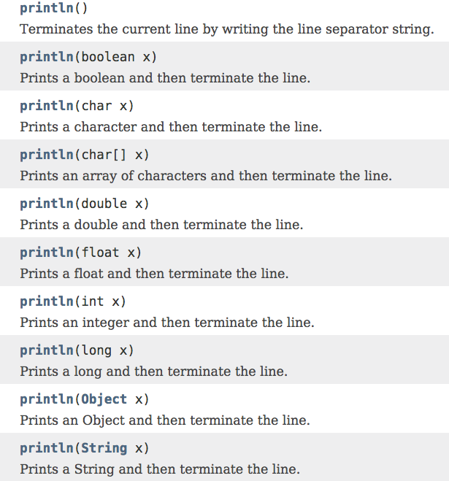
Overloading: Example 2
(Java’s println function API)
Here overloading is used to create a single “printing service” that can be used to print many different data types using “the same” println function.

Slide 47
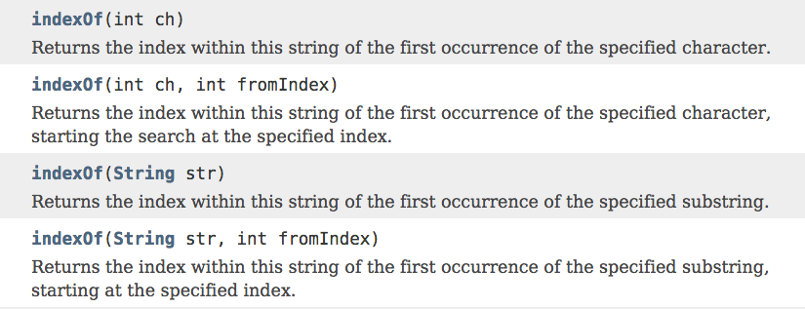
Overloading: Example 3
(Java’s indexOf function API)
str = "It was the best of time";
System.out.println(str.indexOf('t')); // prints 1
System.out.println(str.indexOf('t',3)); // prints 7
System.out.println(str.indexOf("best")); // prints 11
Here overloading is used to feature different variants of “the same” indexOf function.

Slide 48
Functions
Function anatomy
Function call and return
Overloading
Some topics in engineering issues

Slide 49
Modularity
public class MyMath {
public static void main(String args[]) {
double d = hypot(2,1,5,4);
System.out.println(d);
}
/** Euclidean distance between (x1,x2) and (y1,y1) */
public static double hypot(double x1, double y1, double x2, double y2) {
double dx = x2 - x1;
double dy = y2 - y1;
return sqrt(dx*dx + dy*dy);
}
// Computes sqrt(x)
public static double sqrt(double x) {
double epsilon = 0.01;
double g = x;
while (Math.abs(g * g - x) > epsilon) {
g = g - (g * g - x) / (2 * g);
}
return g;
}
...
}
Modularity
Dividing a program into several modules (functions)
Benefits
Reduces:
code complexity
redundant code (errors)
Enables:
Code reuse
Unit testing
Parallel development
At the cost of...
Call and return overhead
Benefits >>> cost

Slide 50
Modularity
public class MyMath {
public static void main(String args[]) {
double d = hypot(2,1,5,4);
System.out.println(d);
}
/** Euclidean distance between (x1,x2) and (y1,y1) */
public static double hypot(double x1, double y1, double x2, double y2) {
double dx = x2 - x1;
double dy = y2 - y1;
return sqrt(dx*dx + dy*dy);
}
// Computes sqrt(x)
public static double sqrt(double x) {
double epsilon = 0.01;
double g = x;
while (Math.abs(g * g - x) > epsilon) {
g = g - (g * g - x) / (2 * g);
}
return g;
}
...
}
Functions in one class can call public functions in other classes:
public class Foo {
...
System.out.println(MyMath.hypot(2,1,5,4));
...
double q = MyMath.sqrt(54267);
...
}
Function calling syntax:
If the callee is in the same class: functionName(argument list)
If the callee is in a different class: ClassName.functionName(argument list)

Slide 51
API
public class Foo {
...
// Computes e raised to the power of x
double y = Math.exp(x);
...
}
exp
The caller’s perspective
When I call a function, …
I view and use the function as a black box abstraction
I don’t care about how it is implemented
I care only about how to use it (documented in the relevant class API)
For example: I search “java 21 Math”
API (“Application Programming Interface”):
Documents the function’s interface
Explains how to use the function.

Slide 52
Typical roles in software development
Class skeleton
public class MyMath {
public static void main(String args[]) {
double d = hypot(2,1,5,4);
System.out.println(d);
}
/** Euclidean distance between (x1,x2) and (y1,y1) */
public static double hypot(double x1, double y1, double x2, double y2) {
return 0;
}
// Computes sqrt(x)
public static double sqrt(double x) {
return 0;
}
...
}
System architect:
Writes a class skeleton:
function signatures, API documentation, and standard tests
Developer:
Implements the functions, adds more tests, as needed
Tester:
Tests everything.

Slide 53
Introduction to Computer Science
Shimon Schocken
IDC Herzliya
Lecture 3-1
Functions
x
y
f
f (x, y, z)
z
Notes:
53

